Slide 1
Like a Script Monkey in the Syntax Tree
Walter Legowski
Notes:
This is the slide shown before the presentation starts. When you are ready to go, tell the video operator to start the recording, and click to the next slide.

Slide 2
5
Video operator, did you start the recording?
Notes:
[REQUIRED SLIDE]
These slides are mandatory and help us with video post-processing. Please keep them as they are.

Slide 3
4
Notes:
[REQUIRED SLIDE]

Slide 4
3
Notes:
[REQUIRED SLIDE]

Slide 5
2
Notes:
[REQUIRED SLIDE]

Slide 6
1
Notes:
[REQUIRED SLIDE]

Slide 7
Like a Script Monkey in the Syntax Tree
Walter Legowski
Notes:
This is your opening. Now the stage is yours!

Slide 8
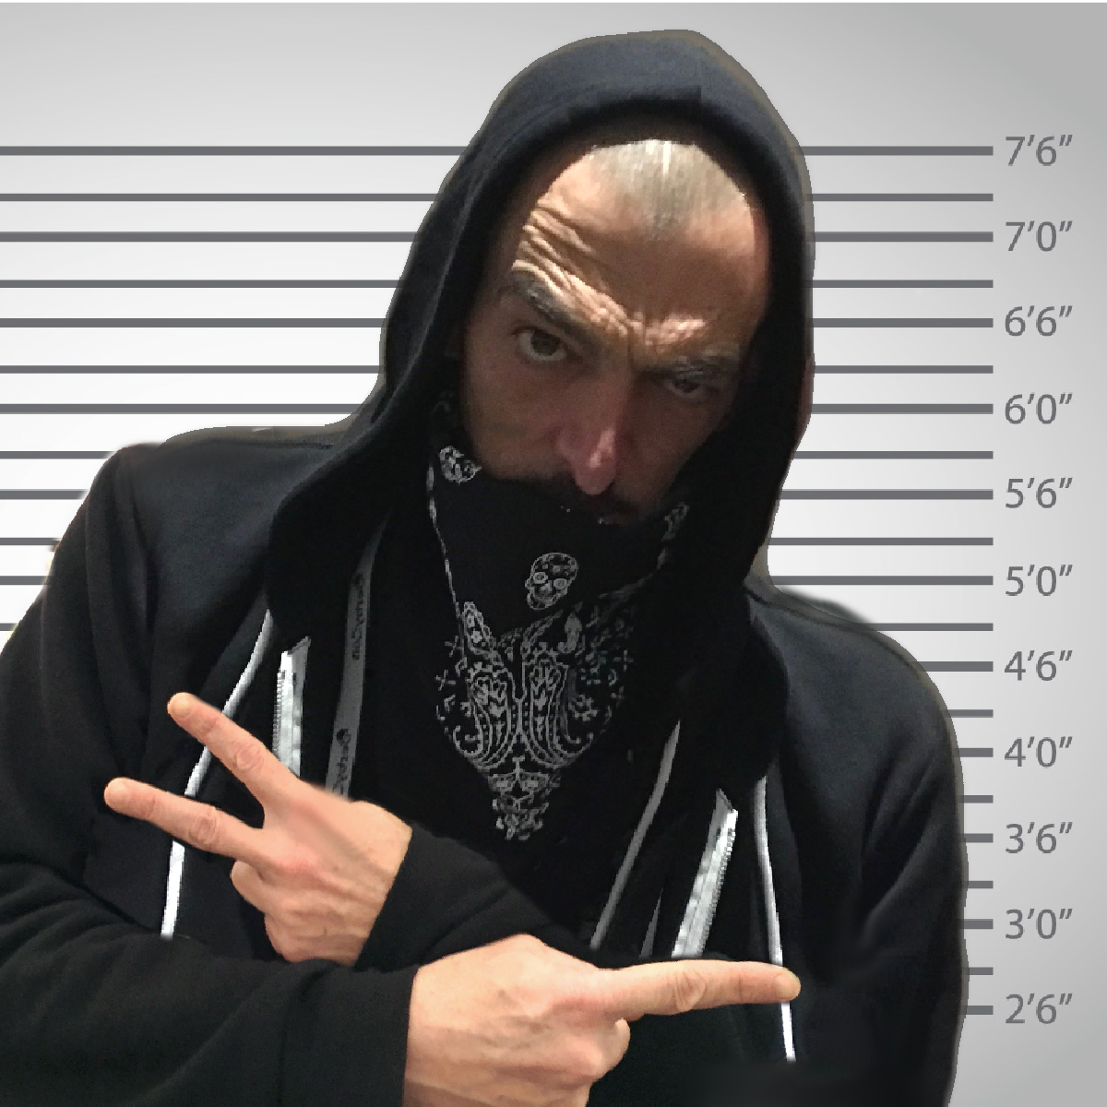
Whois
Walter Legowski @SadProcessor
Security Consultant @ ERNW [Troopers]
Born FR / Home NL / Work DE
Likes Cats / Lego / Memes
Security / Automation / Windows
PowerShell Bad Boy
Notes:
Please invest some time to reconsider your session: what is it that audience can get out of it? Try and be as precise as you can. If you are showing solutions, then focus on “how to”. If you present about a general technology, you’ll want to stick to “Be able to” or “Understand why/how”.

Slide 9
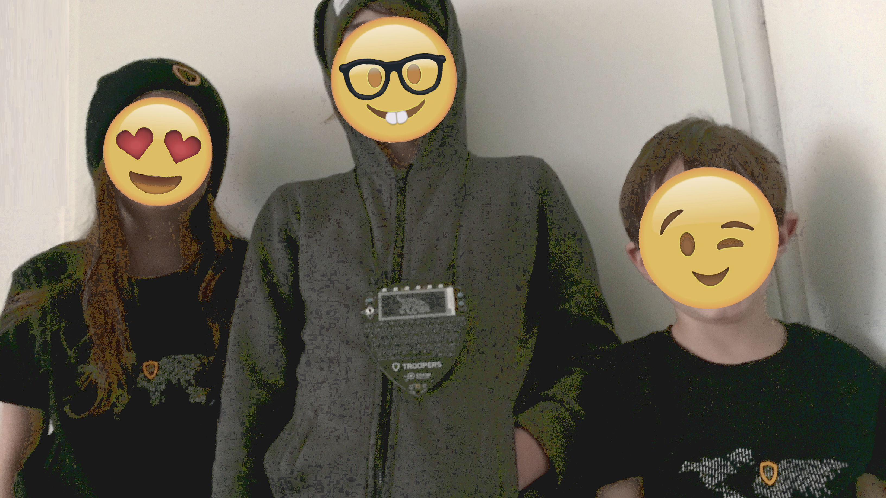
BigUp to my Kids…
My Best Code Commits
❤
Notes:
Please invest some time to reconsider your session: what is it that audience can get out of it? Try and be as precise as you can. If you are showing solutions, then focus on “how to”. If you present about a general technology, you’ll want to stick to “Be able to” or “Understand why/how”.

Slide 10
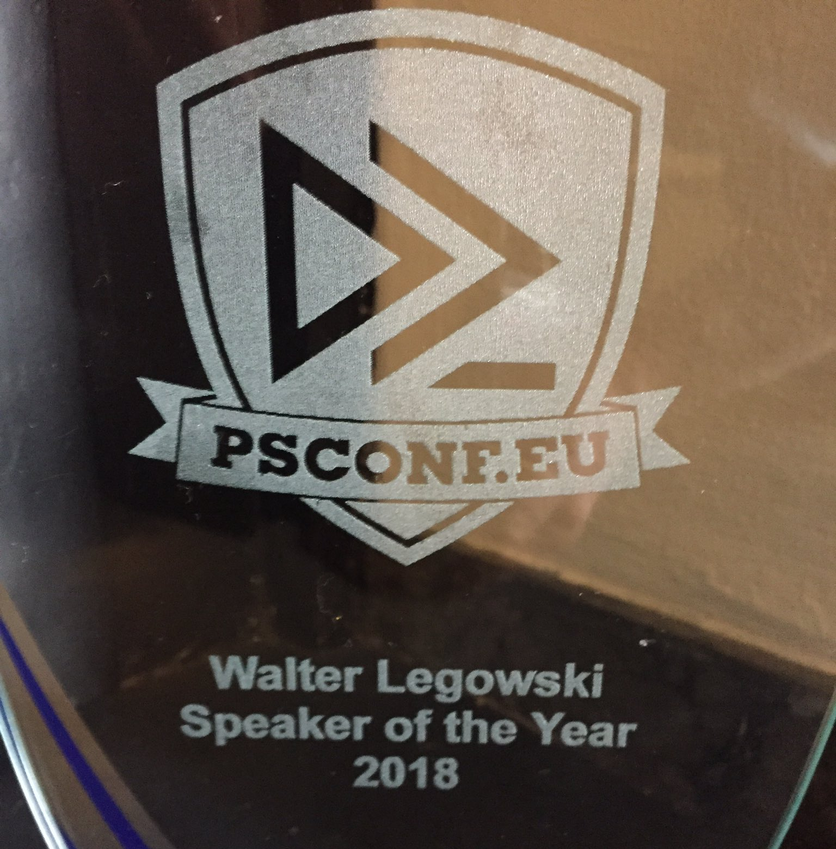
About this…
THANK YOU SO MUCH…
#BlameJaapBrasser
Notes:
Please invest some time to reconsider your session: what is it that audience can get out of it? Try and be as precise as you can. If you are showing solutions, then focus on “how to”. If you present about a general technology, you’ll want to stick to “Be able to” or “Understand why/how”.

Slide 11
This Session
Stuff you can do with PowerShell when you have way too much time…
$psISE
AST
Bob & Alice
ASCII
Beep Tunes
Pizza & more…
Notes:
Please invest some time to reconsider your session: what is it that audience can get out of it? Try and be as precise as you can. If you are showing solutions, then focus on “how to”. If you present about a general technology, you’ll want to stick to “Be able to” or “Understand why/how”.

Slide 12
Agenda
- Playing with the psISE object
- Climbing the AST
- Bob, Alice & Co
- ScriptMonkey
Notes:
Psconf.eu is about demos and code. Try and minimize use of text slides

Slide 13
Before we start…
Since Jeffrey Snover
has changed position at Microsoft,
I decided to stop with
#PowerShell memes
Notes:
Psconf.eu is about demos and code. Try and minimize use of text slides

Slide 14
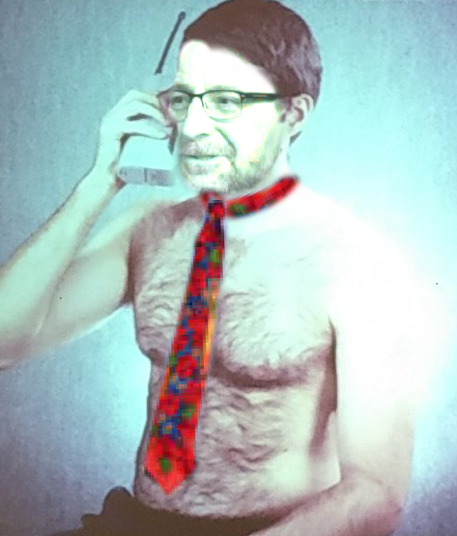
Before we start…
I will therefor not use this meme in my deck today
Notes:
Psconf.eu is about demos and code. Try and minimize use of text slides

Slide 15

Before we start…
☹
☹
Notes:
Psconf.eu is about demos and code. Try and minimize use of text slides

Slide 16
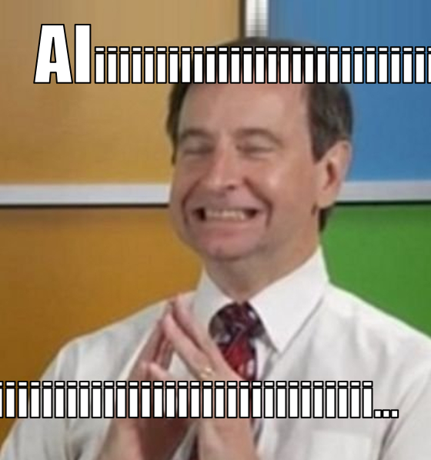
Before we start…
☺
☺
Notes:
Psconf.eu is about demos and code. Try and minimize use of text slides

Slide 17
- psISE Object
- Abstract Syntax Tree
- Bob & Alice
- ScriptMonkey

Slide 18
Summary
It’s amazing what you can do with powershell when you have way too much time…
Make It so…
Notes:
Psconf.eu is about demos and code. Try and minimize use of text slides

Slide 19
Notes:
[REQUIRED SLIDE]
Make sure you provide all materials that audience needs to reproduce your demos.
Either upload them as a PowerShell module to www.powershellgallery.com (preferred for reusable functions)
Or, upload them to our github repository (ask the girls at the info desk to provide you with access)
Or, upload them to your own github repository
Please make sure all materials are available by the time your presentation starts, or at minimum upload them right after your presentation

Slide 20
Notes:
[REQUIRED SLIDE]
If you sticked to your timing, you now have 15 min left for Q&A. If you missed your timing, you will have to leave the room when your slot is over. In this case, invite your audience to the coffee break and offer to cover questions there.
IN ANY CASE please point your audience to the conference app and the session voting. By the time the conference opens, the eventraft app *should* have the option to vote on sessions.
Please MAKE SURE you leave your room when your slot is over. The next speaker would like to set him/herself up and get everything up and running.

Slide 21
Thank You

